Slide 1
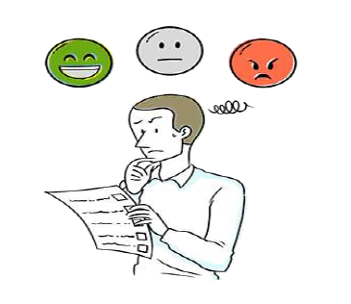
Twitter Sentiment Analysis
Presented By Vivek Vishesh Chauhan Rishabh Jain Vicky Gupta Ramu Bhadraiah

Slide 2
Sentiment Analysis ?
• Sentiment Analysis is the process of determining the emotions of a group of words.
• Also referred to as opinion mining, it makes our goal to determine whether the data(tweet) is positive, negative or neutral.

Slide 3
In public opinions e.g.: • Is this product’s review positive, negative or Neutral? • Is this customer email satisfied or dissatisfied? • Based on a sample of tweets, how are people responding to this ad campaign/product release/news item/controversial topic? • How have blogger’s attitudes, about the president, changed since the election?
Why is Sentiment Analysis Important?

Slide 4
• Popular Microblogging Site • Short Text Messages Of 140 Characters • 240+ Million Active Users • 500 Million Tweets Are Generated Everyday • Twitter Audience Varies From Common Man To Celebrities • Users Often Discuss Current Affairs And Share Personal Views On Various Subjects • Tweets Are Small In Length And Hence Unambiguous
Why Twitter Data for Sentiment Analysis?

Slide 5
Problem Statement
Given a message, decide the nature of message.
For messages conveying both a positive and negative sentiment.
Whichever is with the desired sentiment should be chosen.

Slide 6
Solution
We have implemented our solution using python and ML.
We are using the tweepy for fetching the twits on some particular keywords.
Then we are using the

Slide 7
Challenges
• People express opinions in complex ways.
• In opinion texts, lexical content alone can be misleading.
• Intra-textual and sub-sentential reversal, negation, topic change common.
• Rhetorical devices/modes such as sarcasm, irony, implication, etc.
• Unstructured and also non-grammatical sentences.
• Lexical Variation.
• Out of Vocabulary Words.
• Extensive usage of acronyms like asap, lol, afaik, lmao.

